Slide 1
Parallel Computing
Ekkapot Charoenwanit
Software Systems Engineering
TGGS
KMUTNB

Slide 2
Lecture 3:
Processes and Threads
Synchronization Primitives in Shared Memory Programming

Slide 3
Processes and Programs
A process is an instance of an executing program.
A program is a binary file that contains a range of information that describes how to construct a process at runtime.
Binary Format Identification
Machine Code
Program Entry-Point Address
Data
Symbol & Relocation Tables
Shared Library & Dynamic Library Information
Other Information

Slide 4
Processes
Definition: A process is an abstract entity, defined by the kernel of an OS, to which system resources are allocated in order to execute a program.
From the kernel’s point of view, a process consists of:
User-space memory containing both program code and data used by the code
A range of kernel data structures for maintaining information about the state of the process such as
page table
open file descriptors
signal delivery & handling

Slide 5
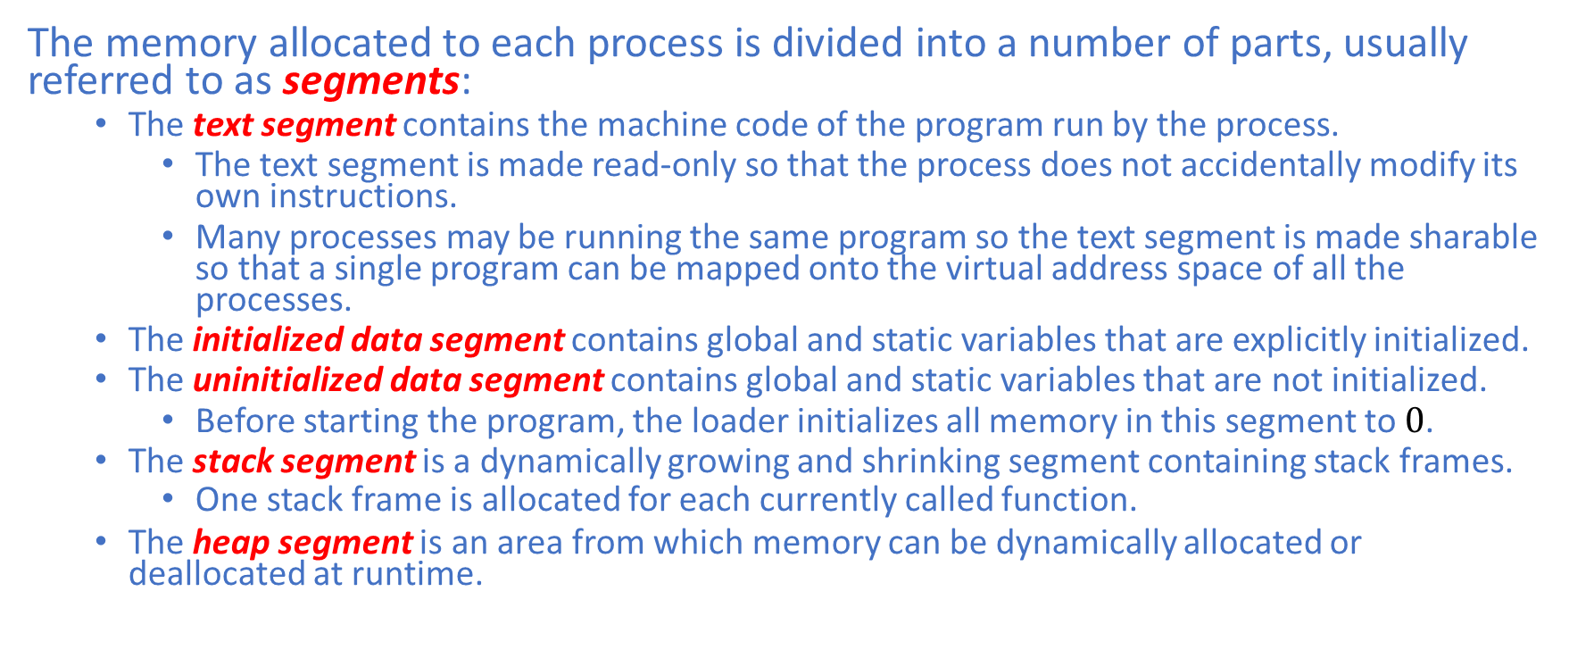
Memory Layout
The memory allocated to each process is divided into a number of parts, usually referred to as segments:
The text segment contains the machine code of the program run by the process.
The text segment is made read-only so that the process does not accidentally modify its own instructions.
Many processes may be running the same program so the text segment is made sharable so that a single program can be mapped onto the virtual address space of all the processes.
The initialized data segment contains global and static variables that are explicitly initialized.
The uninitialized data segment contains global and static variables that are not initialized.
Before starting the program, the loader initializes all memory in this segment to $0$.
The stack segment is a dynamically growing and shrinking segment containing stack frames.
One stack frame is allocated for each currently called function.
The heap segment is an area from which memory can be dynamically allocated or deallocated at runtime.

Slide 6
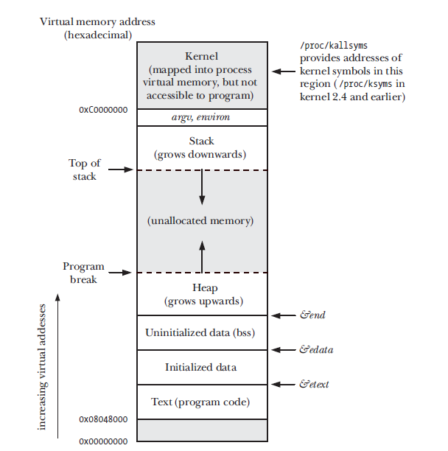
Memory Layout
Typical memory layout of a process on Linux/x86-32

Slide 7
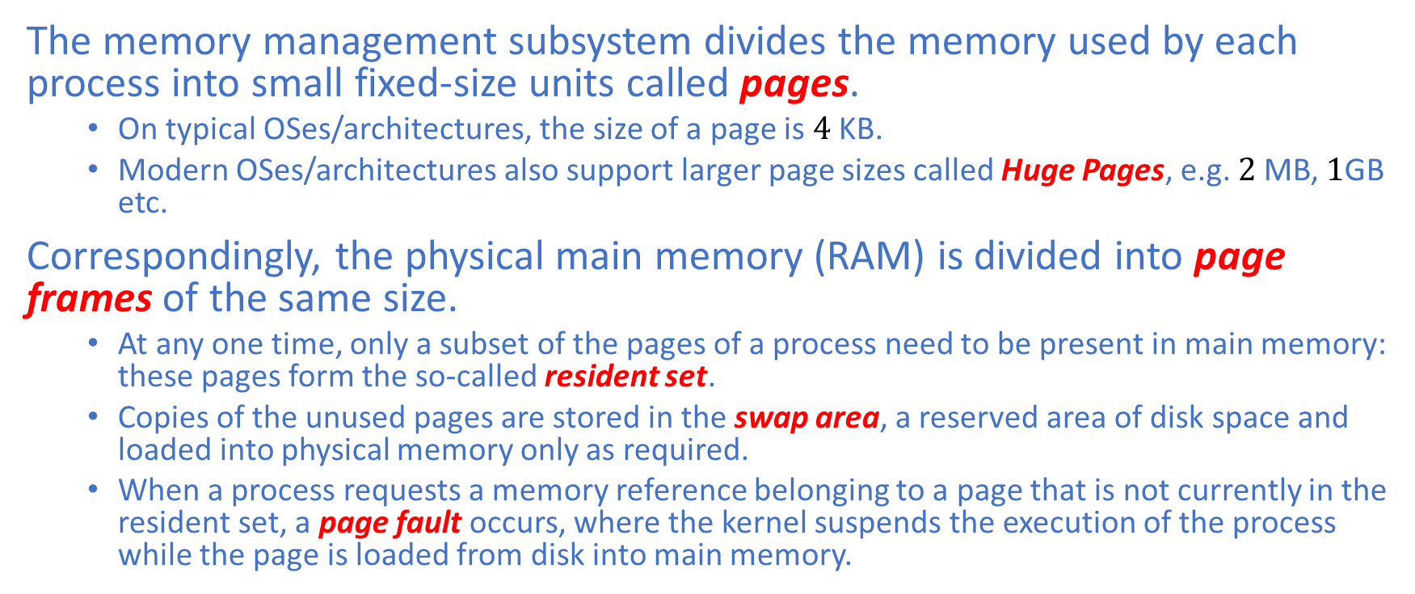
Virtual Memory Management
The memory management subsystem divides the memory used by each process into small fixed-size units called pages.
On typical OSes/architectures, the size of a page is $4$ KB.
Modern OSes/architectures also support larger page sizes called Huge Pages, e.g. $2$MB, $1$GB etc.
Correspondingly, the physical main memory (RAM) is divided into page frames of the same size.
At any one time, only a subset of the pages of a process need to be present in main memory: these pages form the so-called resident set.
Copies of the unused pages are stored in the swap area, a reserved area of disk space and loaded into physical memory only as required.
When a process requests a memory reference belonging to a page that is not currently in the resident set, a page fault occurs, where the kernel suspends the execution of the process while the page is loaded from disk into main memory.

Slide 8
Virtual Memory Management
To support this organization, the OS maintains a page table for each process.
The page table describes the location of each page in the process’s virtual address space.
Each entry in the page table either indicates the location of a virtual page in RAM or indicates that it is currently resident on disk.
Not all address ranges in the process’s virtual address space require page-table entries.
If a process attempts to reference an address for which there is no corresponding page-table entry, it receives a fault: On Linux, a SIGSEGV signal is delivered.
This concept is used to implement the null pointer exception in high-level programming languages.

Slide 9
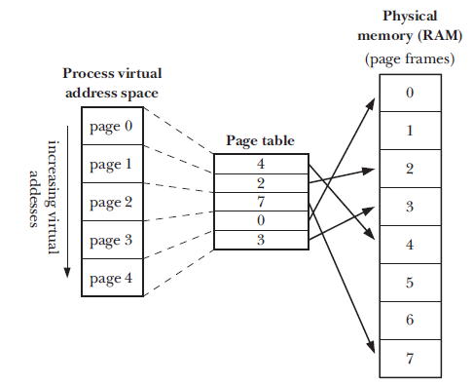
Virtual Memory Management
The memory management subsystem separates the virtual address space of a process from the physical address space of RAM.
Overview of Virtual Memory

Slide 10
Virtual Address Space
This organization provides the following advantages:
Processes are isolated from each other so that one process cannot read or modify the memory of another process.
This is achieved by having the page-table entries point to distinct sets of pages in RAM or in the swap area.
Where appropriate, two or more processes can share memory.
The OS achieves shared memory by having page-table entries in different processes refer to the same pages of RAM.
Programmers, and tools such the compiler and linker do not concern themselves with the physical layout of computer programs in RAM.
Only a part of a program needs to reside in RAM so the program loads and runs faster.
The memory footprint of a process can exceed the amount of RAM available
Since each process requires less RAM at any one time, more processes can simultaneously be held in RAM and this leads to better CPU utilization since there is an increased likelihood that, at any moment, there are more processes resident in RAM that can be readily scheduled on the CPU.

Slide 11
Shared Memory
The sharing of memory between processes occur in two common circumstances:
Multiple processes that execute the same executable can share a single copy of the machine code, i.e., the text segment.
This type of sharing is implicitly performed by the loader and the dynamic linker.
Processes use some system calls to explicitly request sharing of memory regions with other processes for the purpose of interprocess communication, commonly referred to as IPC.

Slide 12
Stack and Stack Frames
The stack grows and shrinks linearly as functions are called and returned.
For Linux/x86 and many UNIX implementations, the stack resides at the high end of the virtual address space and grows downwards towards the heap region:
Each time a function is called, a new stack frame is allocated on the stack
The top of the stack is pointed to by a special-purpose register, known as the stack pointer.

Slide 13
Stack and Stack Frames
Each stack frame contains the following information:
Function arguments and local variables:
In C/C++, these variables are referred to as automatic variables since they are automatically created when a function is called and automatically destroyed when the function returns.
Call linkage information:
Each function uses certain CPU registers, such as the program counter, which points to the next machine instruction to be executed.
Each time a function calls another, a copy of these registers is saved on the callee’s stack frame so that when the function returns, the appropriate register values can be restored for the caller.

Slide 14
Threads
Like processes, threads are a mechanism that allows an application to execute concurrently.
A single process can contain multiple threads, all of which concurrently execute the same program (text segment) and share the same virtual address space.
The threads in a process can execute concurrently.
On a multiprocessor system, multiple threads can execute in parallel.
If one thread is blocked on an I/O operation, other threads can still proceed and execute.

Slide 15
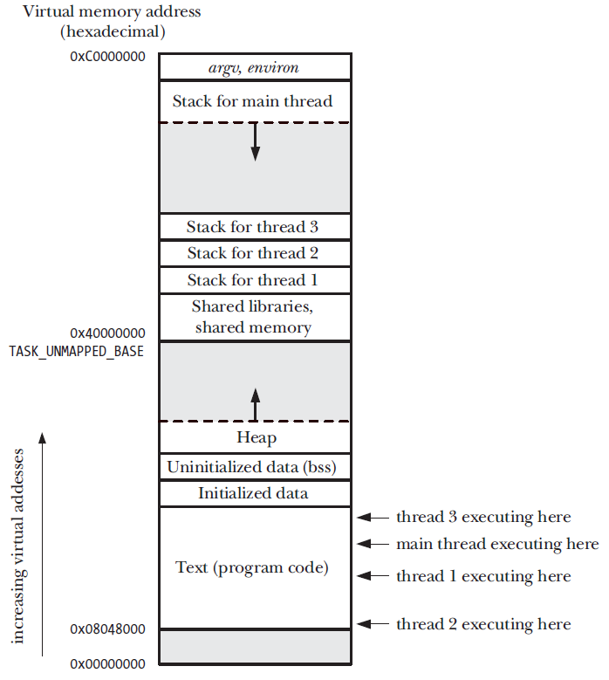
Threads
Typical memory layout of a multithreaded process on Linux/x86-32

Slide 16
Threads
Process:
It is difficult to share information among a multiprocess application even though the processes were created through the fork system call.
The parent and the child do not share the virtual address space although they may share the text segment so some form of IPC must be used to permit the processes in the application to communicate.
The creation of a process with the fork system call is relatively expensive even with the copy-on-write (COW) technique since there must be a separate set of resources such as a page table, a file descriptor table etc.
Thread:
Sharing information between threads is easy and fast since it is just a matter of reading and writing shared variables (data segment+heap segment).
The creation of a thread is faster than that of a process through the clone system call – typically an order of magnitude faster – since they all share the same virtual address space; hence COW is not required.

Slide 17
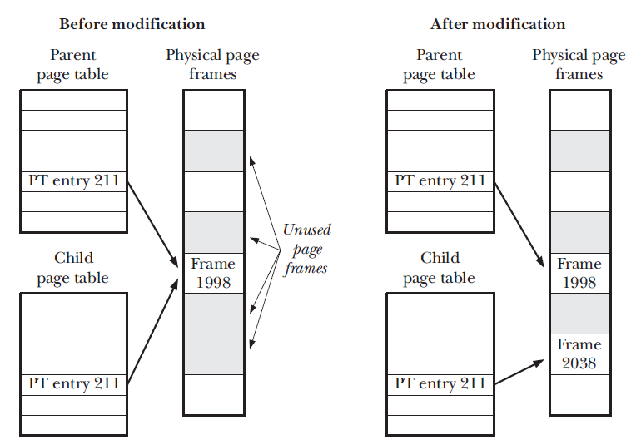
Copy-on-Write
Page tables before and after modification of a shared copy-on-write page

Slide 18
Synchronization Primitives
Tasks frequently need to communicate with each other.
The following three questions can arise:
How do we share data among each other?
How do we make sure that two or more tasks do not get in each other way?
How do we make sure the proper sequencing when dependencies between them are present?
We will discuss 1) in details in the lectures on shared-memory programming.
Let us now focus on 2) and 3), which involves mutual exclusion and synchronization issues, respectively.

Slide 19
Race Conditions
Threads that are working together may share some common storage each one can read and write.
The shared storage may be in main memory or it may be a shared file.
Let us consider a simple example: a printer spooler.
When a process (a user) wants to print a file, it enters the file name in a special spooler directory.
Another process, the printer daemon, periodically checks to see if there are any files to be printed, and if there are, it prints them and then removes their names from the directory.

Slide 20
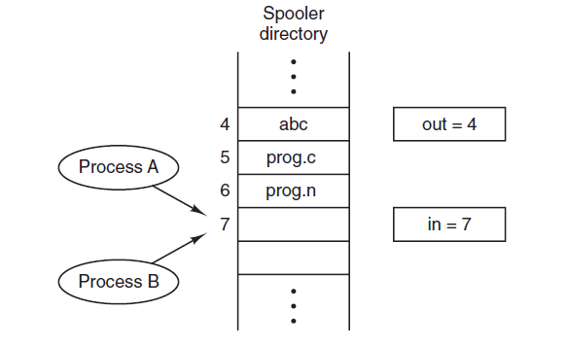

Race Conditions: Printer Spooler
Imagine that
our spooler directory has a very large number of slots, numbered $0$, 1, 2, … each one capable of holding a file name.
there are two shared variables, $out$, which points to the next file to be printed, and $in$, which points to the next free slot.

Slide 21
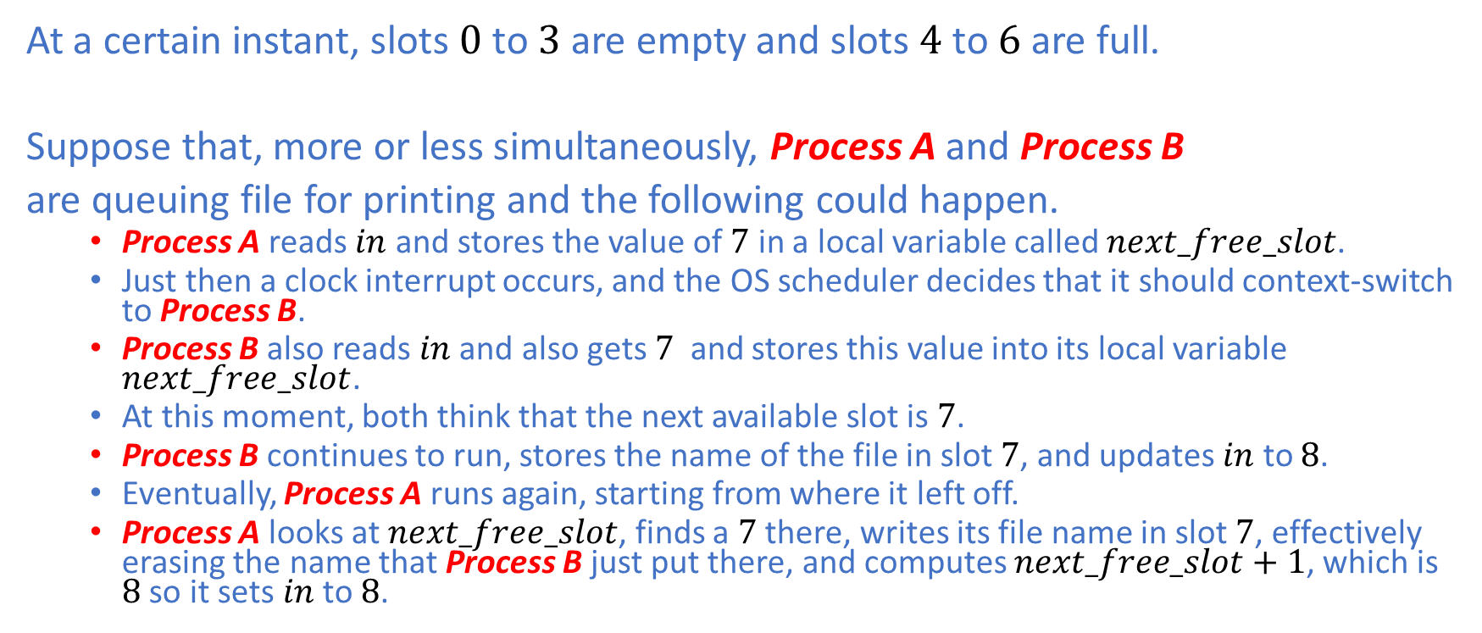
Race Conditions: Printer Spooler
At a certain instant, slots $0$ to $3$ are empty and slots $4$ to $6$ are full.
Suppose that, more or less simultaneously, Process A and Process B
are queuing file for printing and the following could happen.
Process A reads $in$ and stores the value of $7$ in a local variable called $next_free_slot$.
Just then a clock interrupt occurs, and the OS scheduler decides that it should context-switch to Process B.
Process B also reads $in$ and also gets $7$ and stores this value into its local variable $next_free_slot$.
At this moment, both think that the next available slot is $7$.
Process B continues to run, stores the name of the file in slot $7$, and updates $in$ to $8$.
Eventually, Process A runs again, starting from where it left off.
Process A looks at $next_free_slot$, finds a $7$ there, writes its file name in slot $7$, effectively erasing the name that Process B just put there, and computes $next_free_slot+1$, which is $8$ so it sets $in$ to $8$.

Slide 22
Race Conditions: Printer Spooler
What has gone wrong?
The printer daemon will not notice anything wrong, but Process B will never get its file printed.
Situations like this, where two or more processes are reading or writing some shared data and the final result depends on who runs precisely when, are called race conditions.

Slide 23
Critical Section
How do we avoid race conditions?
We must find a way to prohibit more than one process from reading and writing shared data at the same time.
In other words, what we need is mutual exclusion.
The problem of avoiding race conditions can also be formulated in a general way as follows:
Part of the time, a process is busy doing local computations and other things that do not lead to race conditions.
However, sometimes, a process has to access shared memory or files, which can lead to races.
That part of the program where the shared memory is accessed is called a critical section.

Slide 24
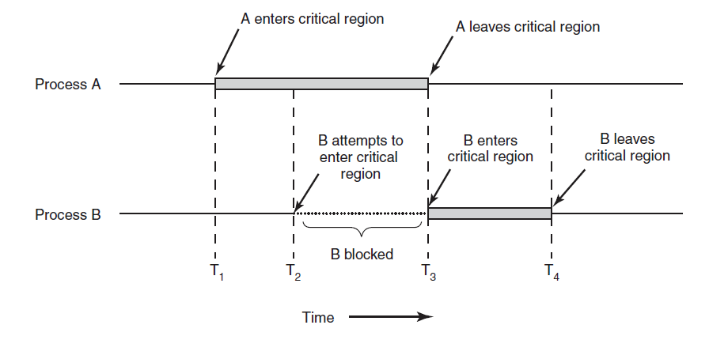
Critical Section

Slide 25
Mutual Exclusion: Disabling Interrupts
On a uniprocessor system, the simplest solution is to have each process
disable all interrupts just after entering its critical section
re-enable them just before leaving it
With interrupts disabled, no clock interrupts can occur to trigger a context switch to another process.
Thus, once a process has disabled interrupts, it can examine and update the shared memory without fear that any other processes will intervene.
It is unwise to give user processes the power to turn off interrupts.
What if one of them did it, and never turned them on again?
That could be the end of the system.
Moreover, disabling interrupts cannot avoid race conditions on multiprocessor system.
Disabling interrupts affects only the CPU that executed the CLI instruction.
Disabling interrupts is often a useful technique within the OS kernel itself but it is not appropriate as a general mutual exclusion mechanism for user processes.

Slide 26

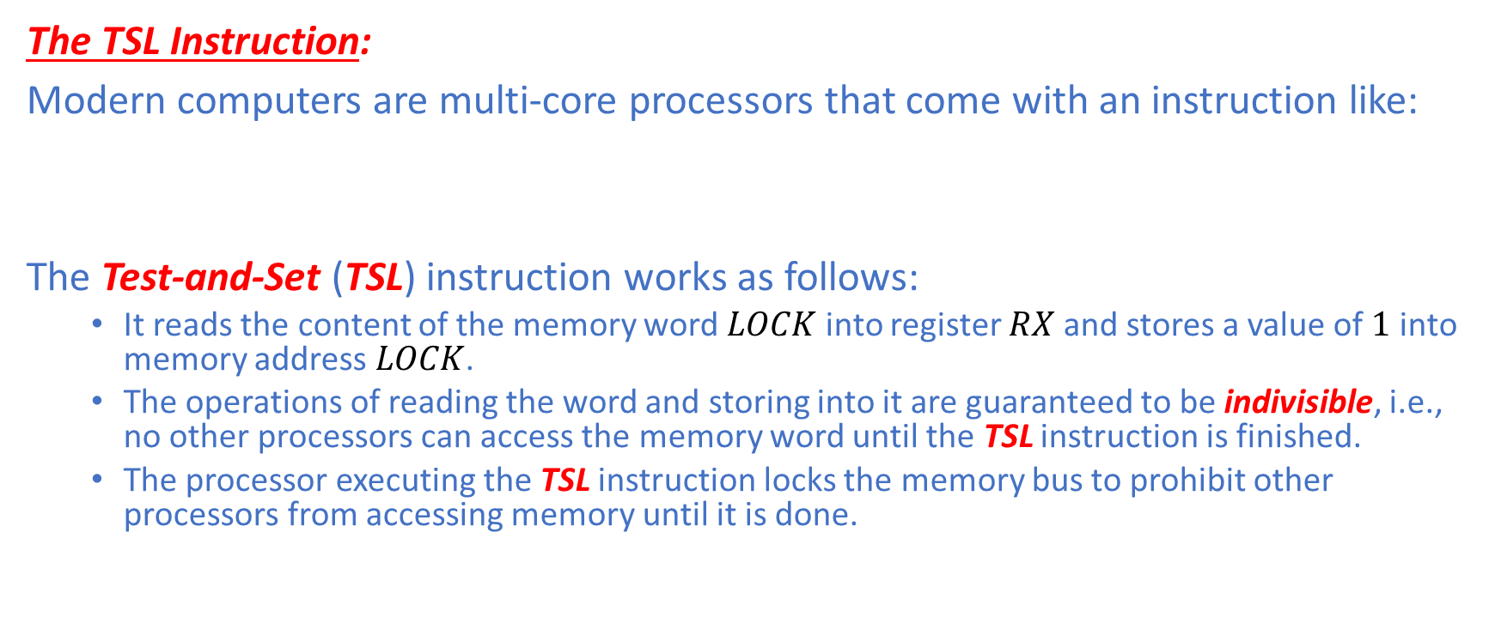
Mutual Exclusion: Spinlocks
The TSL Instruction:
Modern computers are multi-core processors that come with an instruction like:
The Test-and-Set (TSL) instruction works as follows:
It reads the content of the memory word $LOCK$ into register $RX$ and stores a value of $1$ into memory address $LOCK$.
The operations of reading the word and storing into it are guaranteed to be indivisible, i.e., no other processors can access the memory word until the TSL instruction is finished.
The processor executing the TSL instruction locks the memory bus to prohibit other processors from accessing memory until it is done.

Slide 27
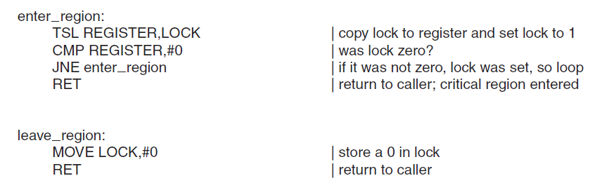
Mutual Exclusion: Spinlock
The TSL Instruction:

Slide 28
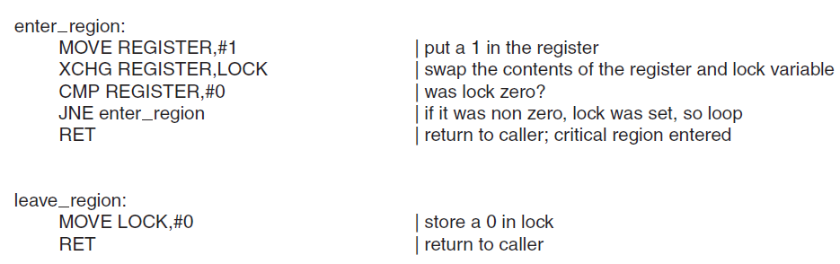
Mutual Exclusion: Spinlock
An alternative to TSL is XCHG, which exchanges the contents of two locations atomically, for example, a register and a memory word.
All Intel x86 CPUs use the XCHG instruction for low-level synchronization.

Slide 29
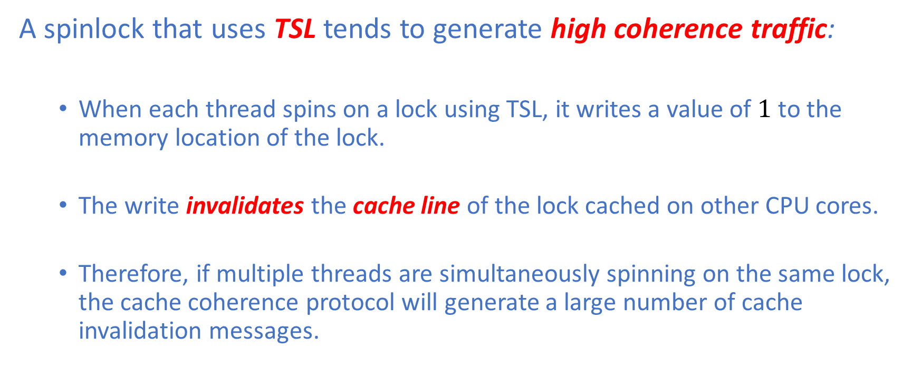
Mutual Exclusion: Spinlock
A spinlock that uses TSL tends to generate high coherence traffic:
When each thread spins on a lock using TSL, it writes a value of $1$to the memory location of the lock.
The write invalidates the cache line of the lock cached on other CPU cores.
Therefore, if multiple threads are simultaneously spinning on the same lock, the cache coherence protocol will generate a large number of cache invalidation messages.

Slide 30
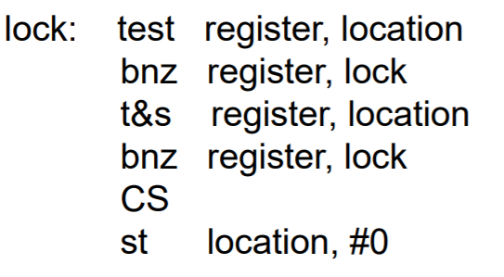
Mutual Exclusion: Spinlock
This issue can be mitigated by using the Test-and-Test-and-Set technique, which relies on the fact that reading does not generate coherence traffic if the lock is cached locally.

Slide 31
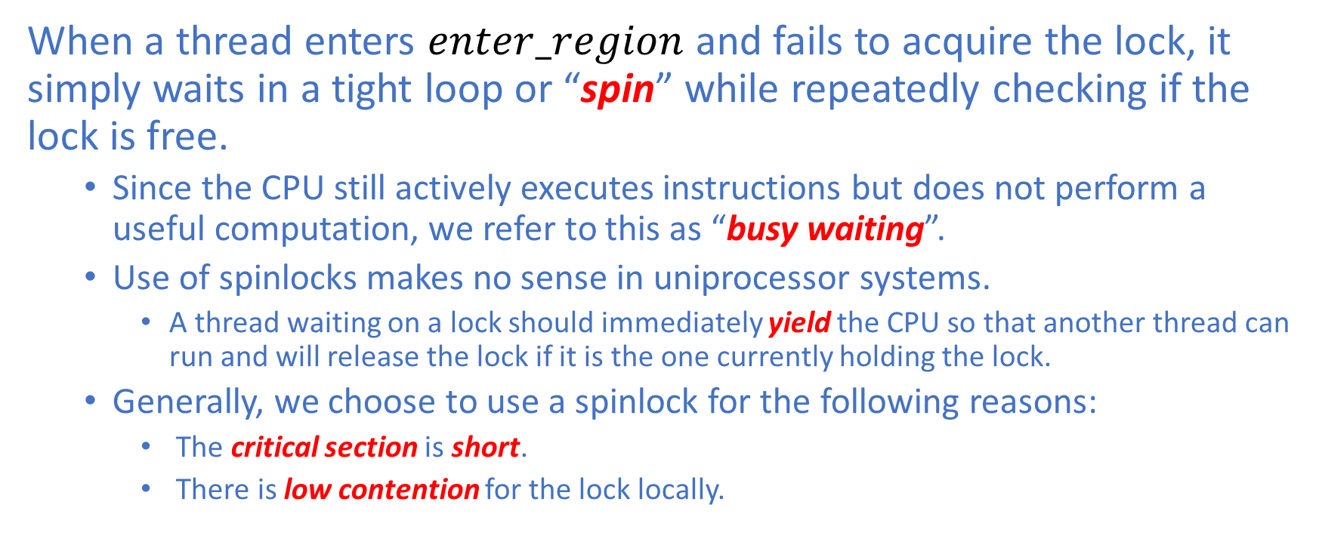
Mutual Exclusion: Spinlock
When a thread enters $enter_region$ and fails to acquire the lock, it simply waits in a tight loop or “spin” while repeatedly checking if the lock is free.
Since the CPU still actively executes instructions but does not perform a useful computation, we refer to this as “busy waiting”.
Use of spinlocks makes no sense in uniprocessor systems.
A thread waiting on a lock should immediately yield the CPU so that another thread can run and will release the lock if it is the one currently holding the lock.
Generally, we choose to use a spinlock for the following reasons:
The critical section is short.
There is low contention for the lock locally.

Slide 32
Mutual Exclusion: Spinlock
Spin vs Sleep and Wake up:
Spinning wastes CPU cycles for no useful task.
Sleep and Wake up, which means yielding the CPU and context-switching to a new process or thread, incurs a relatively high overhead for the following reasons:
Saving and restoring contexts are expensive
Cache working sets will change across context switches
TLB needs to be flushed if a different process is picked by the OS scheduler.
Modern CPUs support Process-Context Identifiers.
Generally, if the lock is held for a period of time smaller than the overhead of context-switching, it is better to use spinlocks.

Slide 33
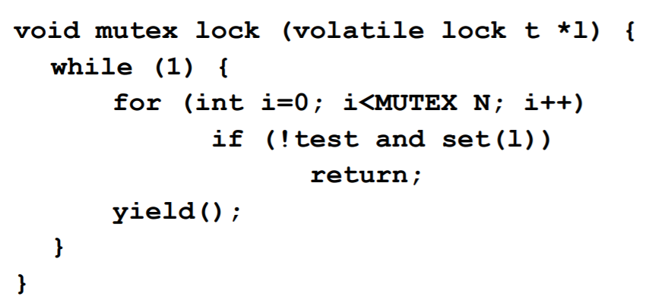
Mutual Exclusion: Spinlock
Spinning Approaches:
Keep spinning until the lock is acquired
Spin only for some amount of time and yield if the lock is not acquired.

Slide 34
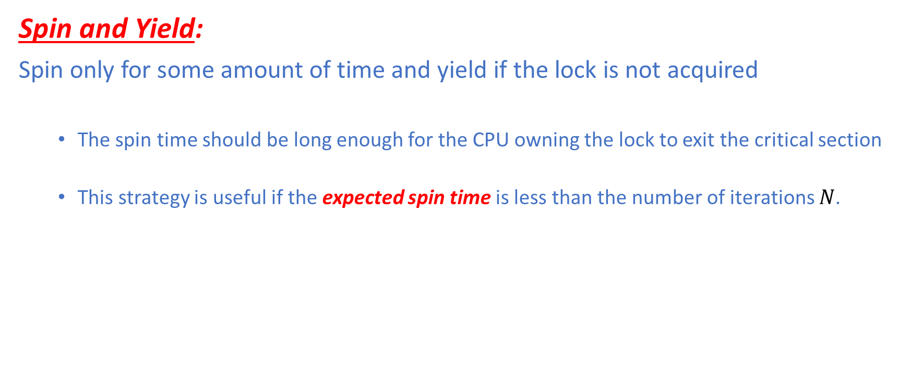
Mutual Exclusion: Spinlock
Spin and Yield:
Spin only for some amount of time and yield if the lock is not acquired
The spin time should be long enough for the CPU owning the lock to exit the critical section
This strategy is useful if the expected spin time is less than the number of iterations $N$.

Slide 35
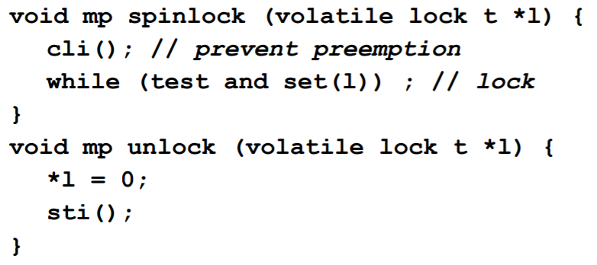
Mutual Exclusion: Spinlock
Disable Interrupts and Spin:
Disable interrupts before spinning and re-enable interrupts after releasing the lock.
Efficient for short critical sections
Not appropriate for user-mode processes or threads

Slide 36
Sleep and Wake up
In stead of spinning in a tight loop waiting on the lock, a process or a thread can, instead, yield by putting itself to sleep and thereby trigger a context switch.
There are a few blocking synchronization primitives we will discuss.
Semaphore
Mutex
Condition Variable
Monitor

Slide 37
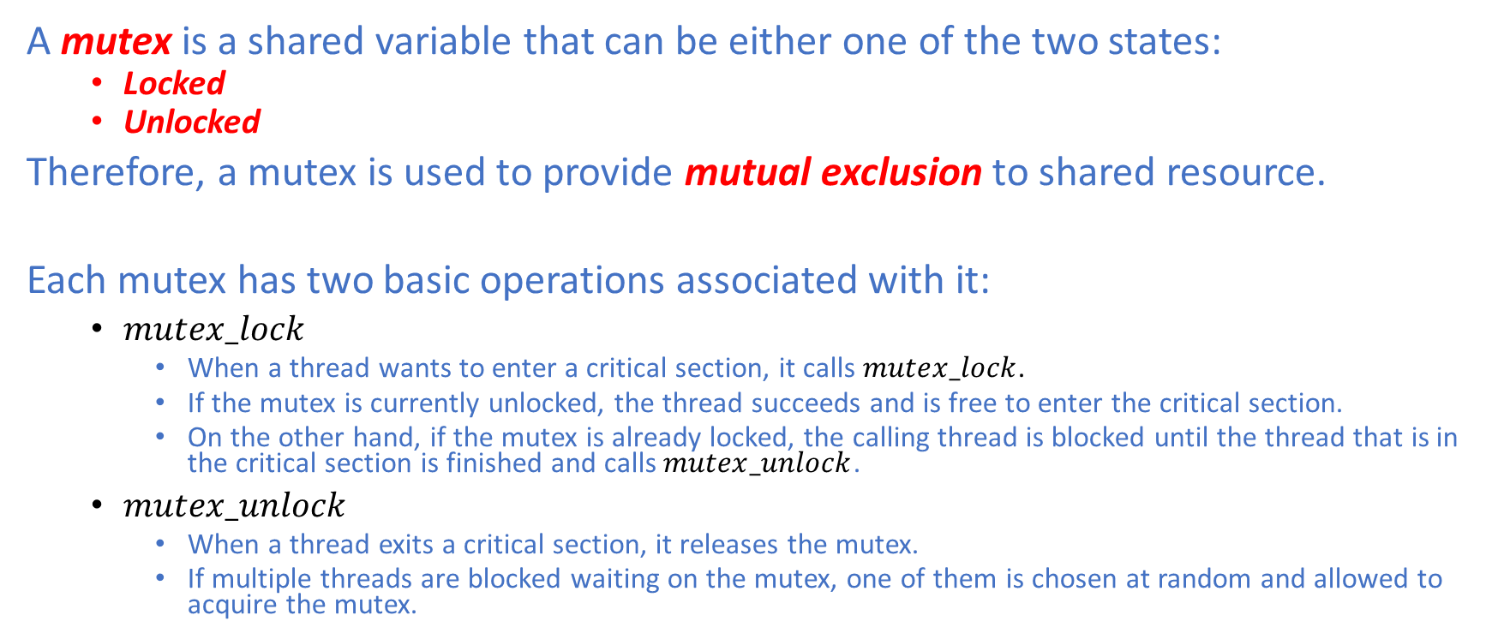
Mutex
A mutex is a shared variable that can be either one of the two states:
Locked
Unlocked
Therefore, a mutex is used to provide mutual exclusion to shared resource.
Each mutex has two basic operations associated with it:
$mutex_lock$
When a thread wants to enter a critical section, it calls $mutex_lock$.
If the mutex is currently unlocked, the thread succeeds and is free to enter the critical section.
On the other hand, if the mutex is already locked, the calling thread is blocked until the thread that is in the critical section is finished and calls $mutex_unlock$.
$mutex_unlock$
When a thread exits a critical section, it releases the mutex.
If multiple threads are blocked waiting on the mutex, one of them is chosen at random and allowed to acquire the mutex.

Slide 38
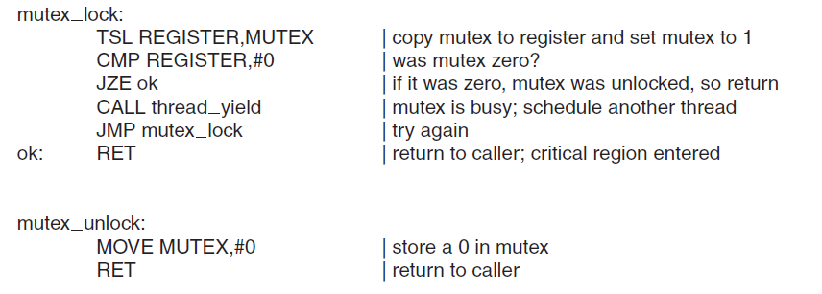
Mutex: Implementation

Slide 39
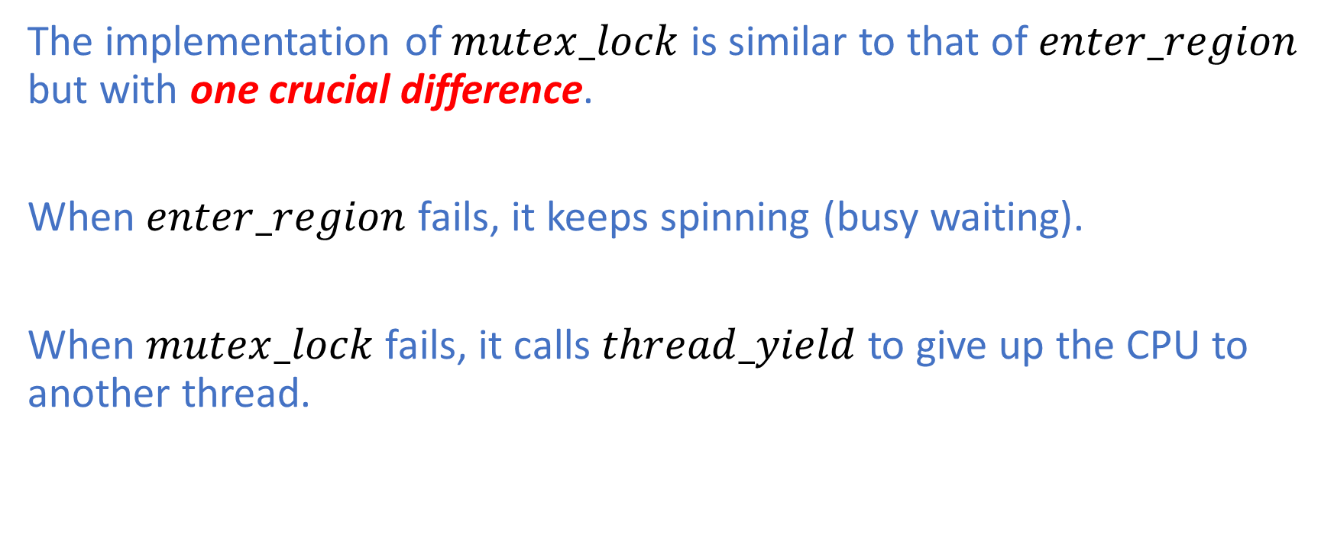
Mutex: Mutex vs Spinlock
The implementation of $mutex_lock$ is similar to that of $enter_region$ but with one crucial difference.
When $enter_region$ fails, it keeps spinning (busy waiting).
When $mutex_lock$ fails, it calls $thread_yield$ to give up the CPU to another thread.

Slide 40
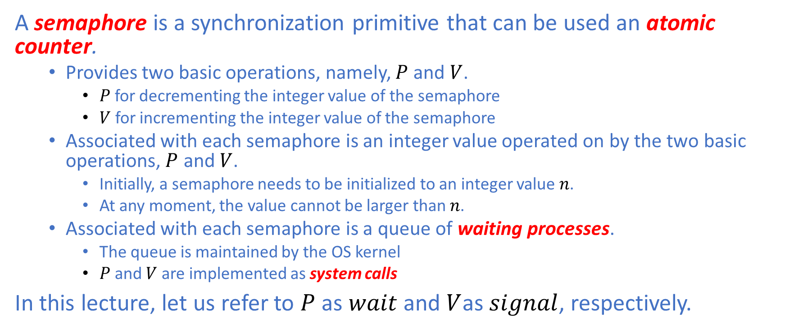
Semaphore
A semaphore is a synchronization primitive that can be used an atomic counter.
Provides two basic operations, namely, $P$ and $V$.
$P$ for decrementing the integer value of the semaphore
$V$ for incrementing the integer value of the semaphore
Associated with each semaphore is an integer value operated on by the two basic operations, $P$ and $V$.
Initially, a semaphore needs to be initialized to an integer value $n$.
At any moment, the value cannot be larger than $n$.
Associated with each semaphore is a queue of waiting processes.
The queue is maintained by the OS kernel
$P$ and $V$are implemented as system calls
In this lecture, let us refer to $P$ as $wait$ and $V$as $signal$, respectively.

Slide 41
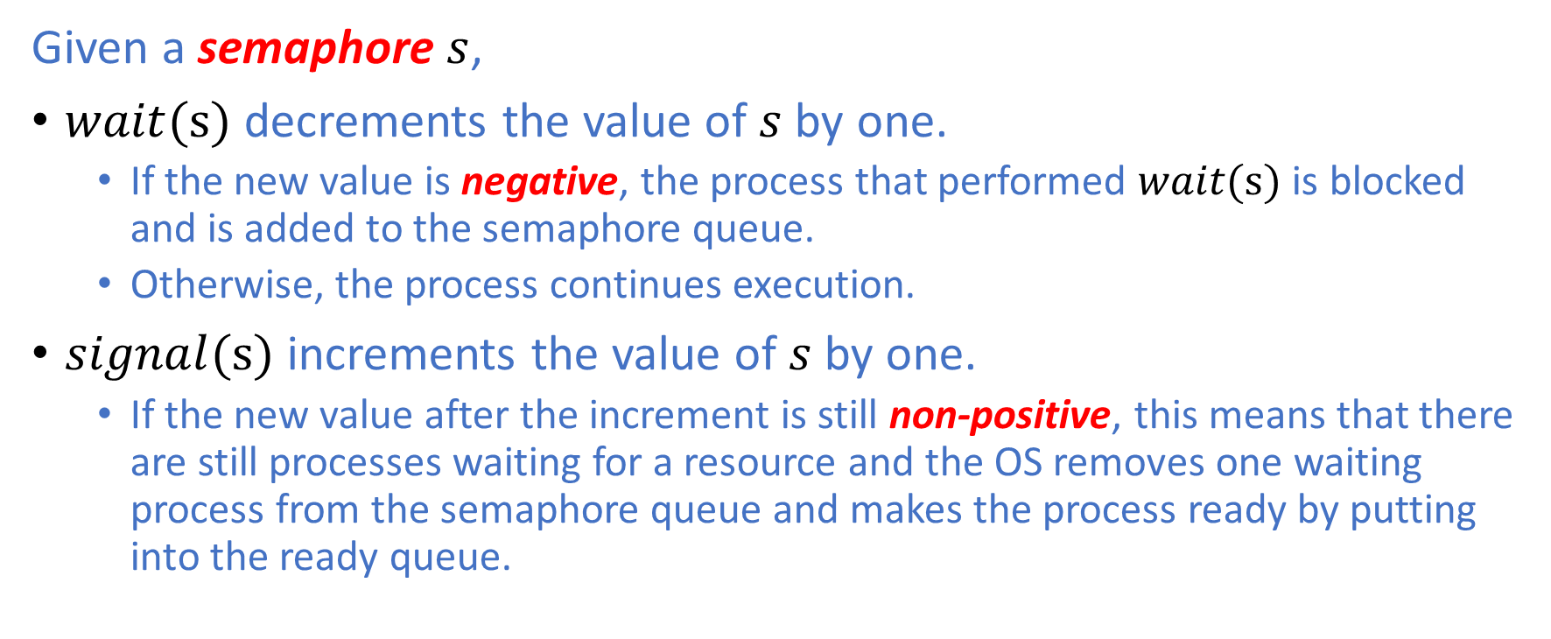
Semaphore: Basic Operations
Given a semaphore $s$,
$wait(s)$ decrements the value of $s$ by one.
If the new value is negative, the process that performed $wait(s)$ is blocked and is added to the semaphore queue.
Otherwise, the process continues execution.
$signal(s)$ increments the value of $s$ by one.
If the new value after the increment is still non-positive, this means that there are still processes waiting for a resource and the OS removes one waiting process from the semaphore queue and makes the process ready by putting into the ready queue.

Slide 42
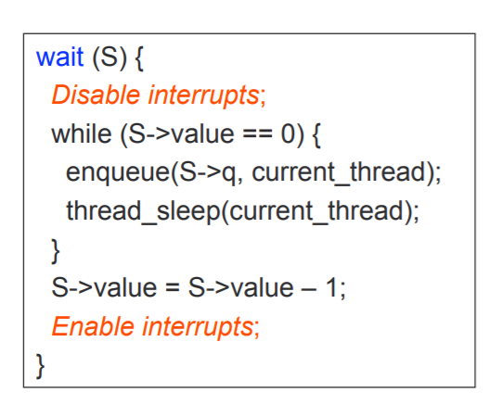
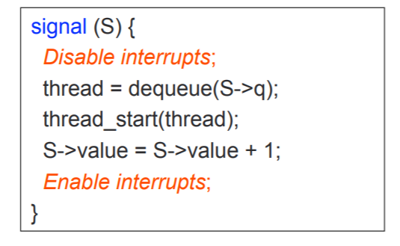
Semaphore: Implementation

Slide 43
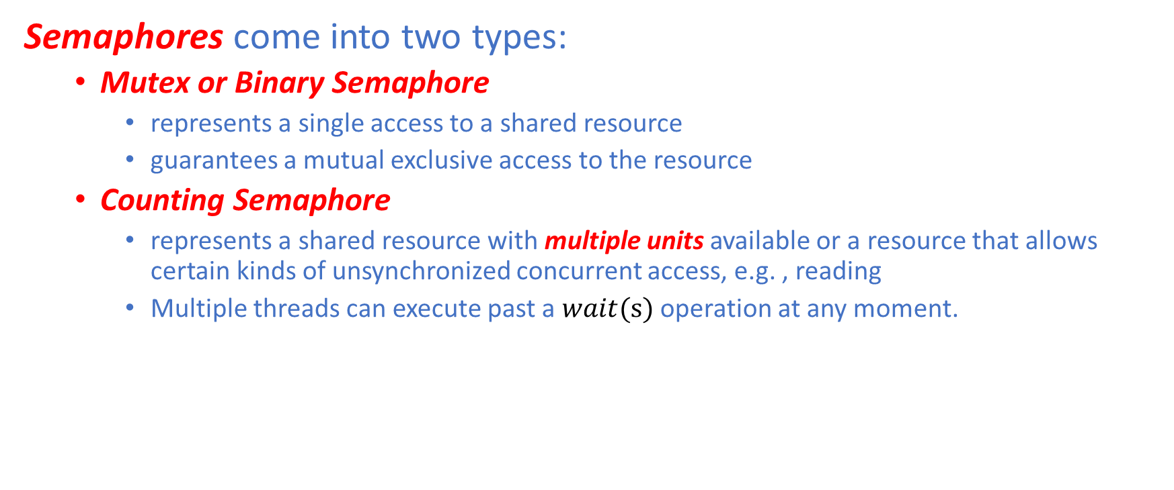
Semaphore: Types
Semaphores come into two types:
Mutex or Binary Semaphore
represents a single access to a shared resource
guarantees a mutual exclusive access to the resource
Counting Semaphore
represents a shared resource with multiple units available or a resource that allows certain kinds of unsynchronized concurrent access, e.g. , reading
Multiple threads can execute past a $wait(s)$ operation at any moment.

Slide 44
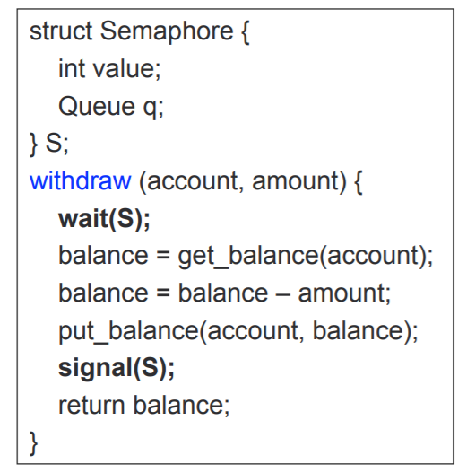
Semaphore: Mutual Exclusion Problem

Slide 45
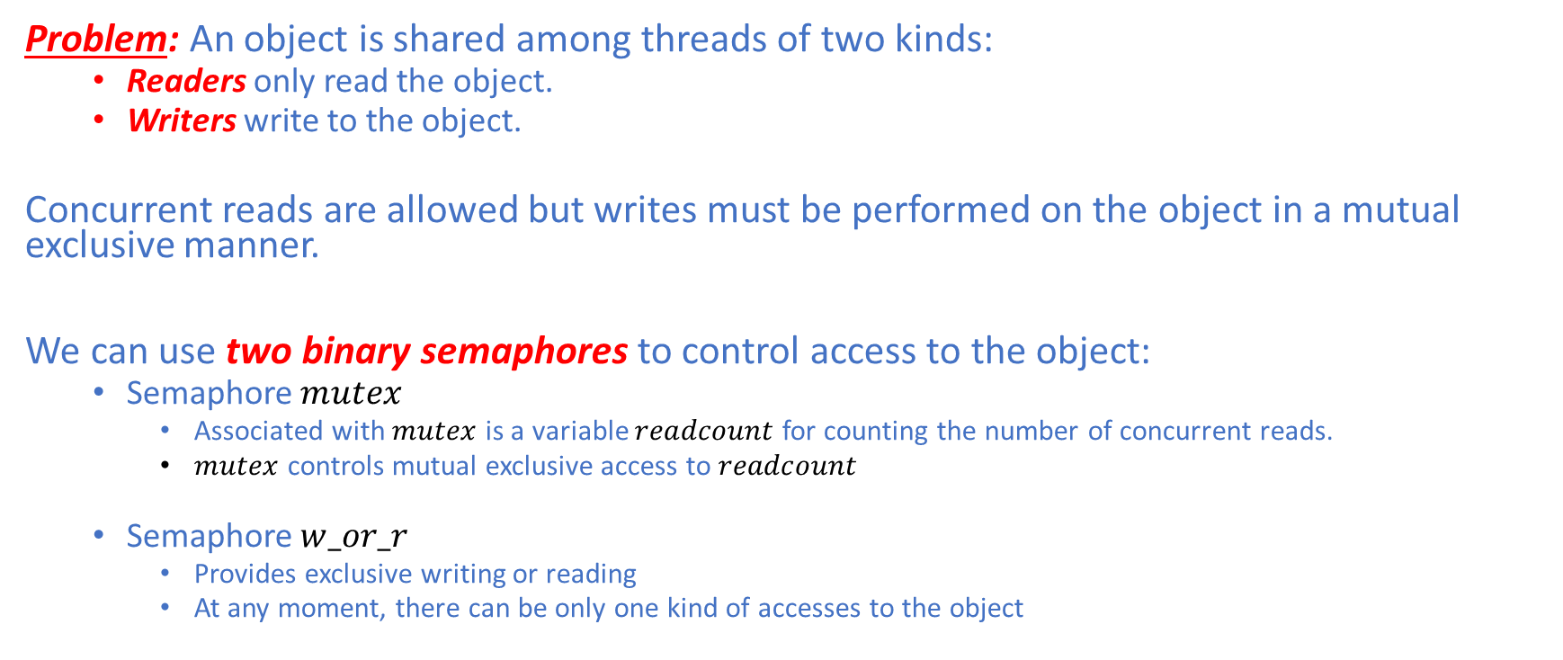
Semaphore: Readers-Writers Problem
Problem: An object is shared among threads of two kinds:
Readers only read the object.
Writers write to the object.
Concurrent reads are allowed but writes must be performed on the object in a mutual exclusive manner.
We can use two binary semaphores to control access to the object:
Semaphore $mutex$
Associated with $mutex$ is a variable $readcount$ for counting the number of concurrent reads.
$mutex$ controls mutual exclusive access to $readcount$
Semaphore $w_or_r$
Provides exclusive writing or reading
At any moment, there can be only one kind of accesses to the object

Slide 46
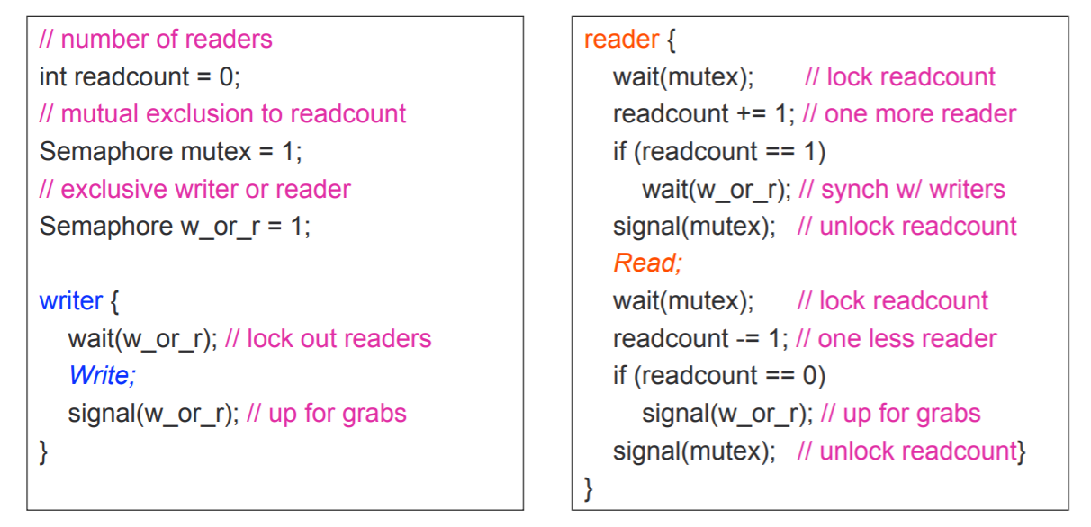
Semaphore: Readers-Writers Problem

Slide 47
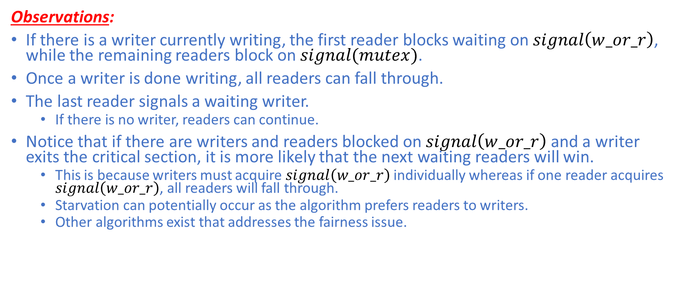
Semaphore: Readers-Writers Problem
Observations:
If there is a writer currently writing, the first reader blocks waiting on $signal\left(w_or_r\right)$, while the remaining readers block on $signal(mutex)$.
Once a writer is done writing, all readers can fall through.
The last reader signals a waiting writer.
If there is no writer, readers can continue.
Notice that if there are writers and readers blocked on $signal\left(w_or_r\right)$and a writer exits the critical section, it is more likely that the next waiting readers will win.
This is because writers must acquire $signal\left(w_or_r\right)$ individually whereas if one reader acquires $signal\left(w_or_r\right)$, all readers will fall through.
Starvation can potentially occur as the algorithm prefers readers to writers.
Other algorithms exist that addresses the fairness issue.

Slide 48
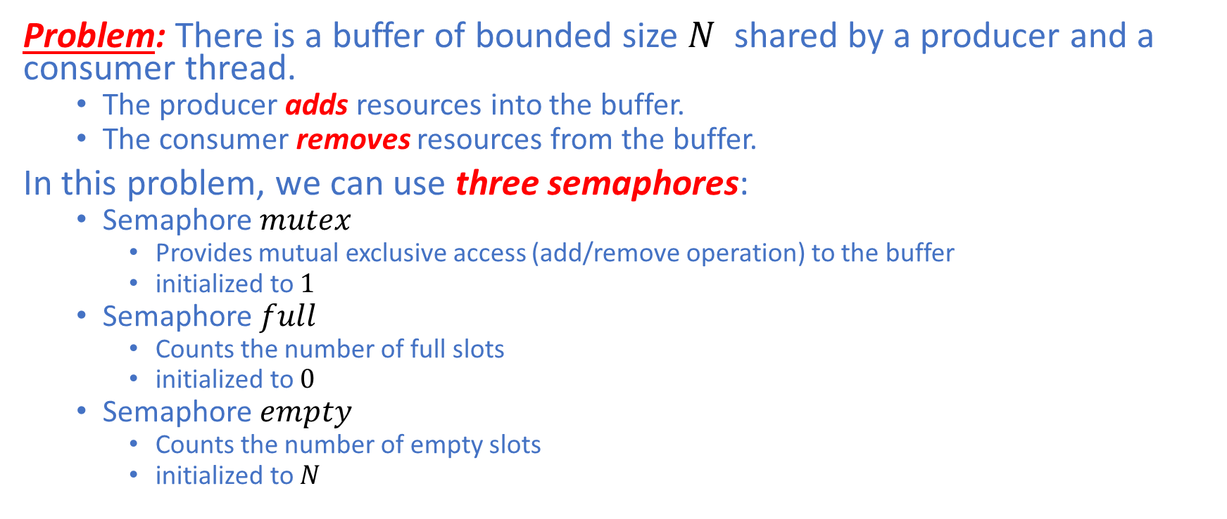
Semaphore: Bounded Buffer Problem
Problem: There is a buffer of bounded size $N$ shared by a producer and a consumer thread.
The producer adds resources into the buffer.
The consumer removes resources from the buffer.
In this problem, we can use three semaphores:
Semaphore $mutex$
Provides mutual exclusive access (add/remove operation) to the buffer
initialized to $1$
Semaphore $full$
Counts the number of full slots
initialized to $0$
Semaphore $empty$
Counts the number of empty slots
initialized to $N$

Slide 49
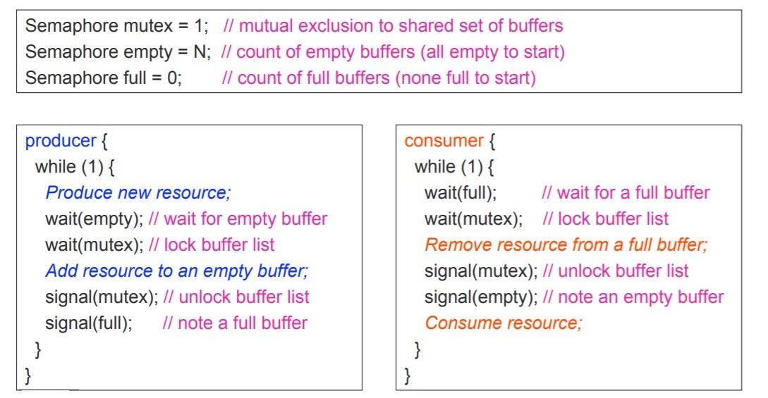
Semaphore: Bounded Buffer Problem

Slide 50
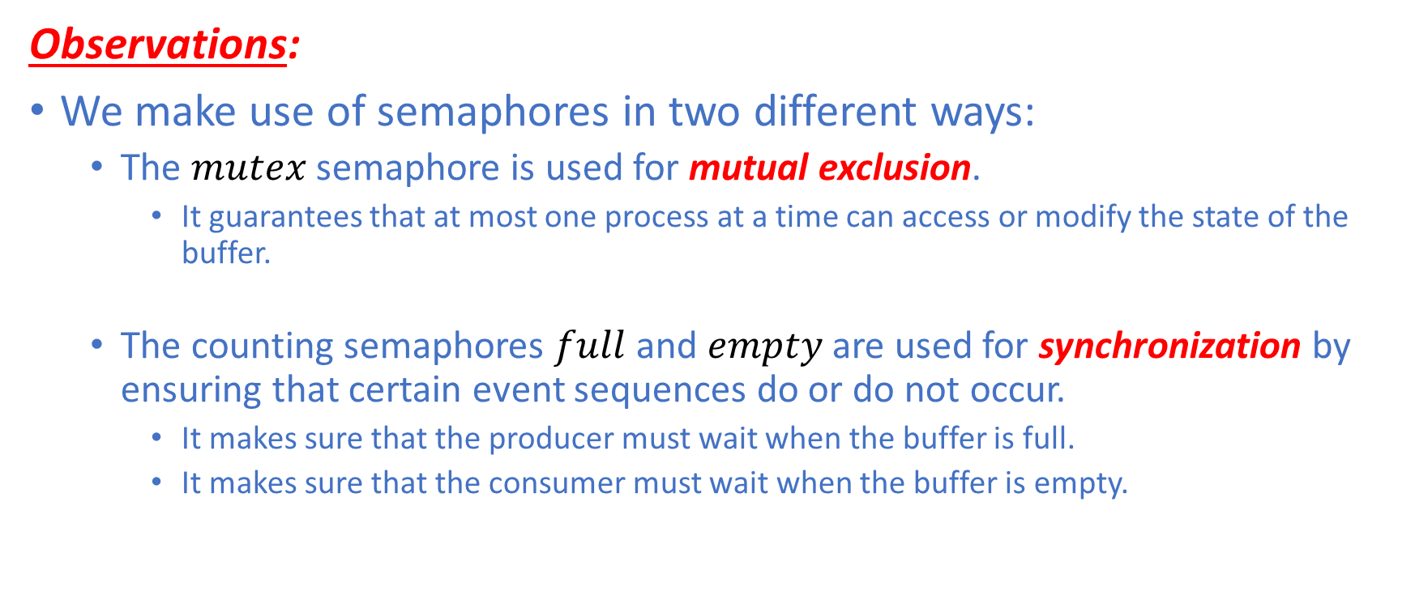
Semaphore: Bounded Buffer Problem
Observations:
We make use of semaphores in two different ways:
The $mutex$ semaphore is used for mutual exclusion.
It guarantees that at most one process at a time can access or modify the state of the buffer.
The counting semaphores $full$ and $empty$ are used for synchronization by ensuring that certain event sequences do or do not occur.
It makes sure that the producer must wait when the buffer is full.
It makes sure that the consumer must wait when the buffer is empty.

Slide 51
Monitor
A monitor is a OOP-style construct that provides structured synchronized access to shared data:
Encapsulates data to be shared between threads
Provides methods for operating on those shared data in such a way that at most one thread can call a method and be inside the monitor at a time – hence mutual exclusion
Methods define critical sections.
In effect, a monitor protects its shared data from unstructured accesses through their “monitor methods”.

Slide 52
Monitor
A monitor provides mutual exclusion:
Only one thread can execute any monitor method at a time.
We say that the thread is “in the monitor”.
If a second thread attempts to call a monitor method, when a first thread is already in the monitor, the second thread is blocked.
The monitor will add the blocked thread to the ready queue.
If the thread in the monitor is blocked, a different thread can enter the monitor.
A monitor also provides synchronization through the use of condition variables, which we will talk about in the next few slides.

Slide 53
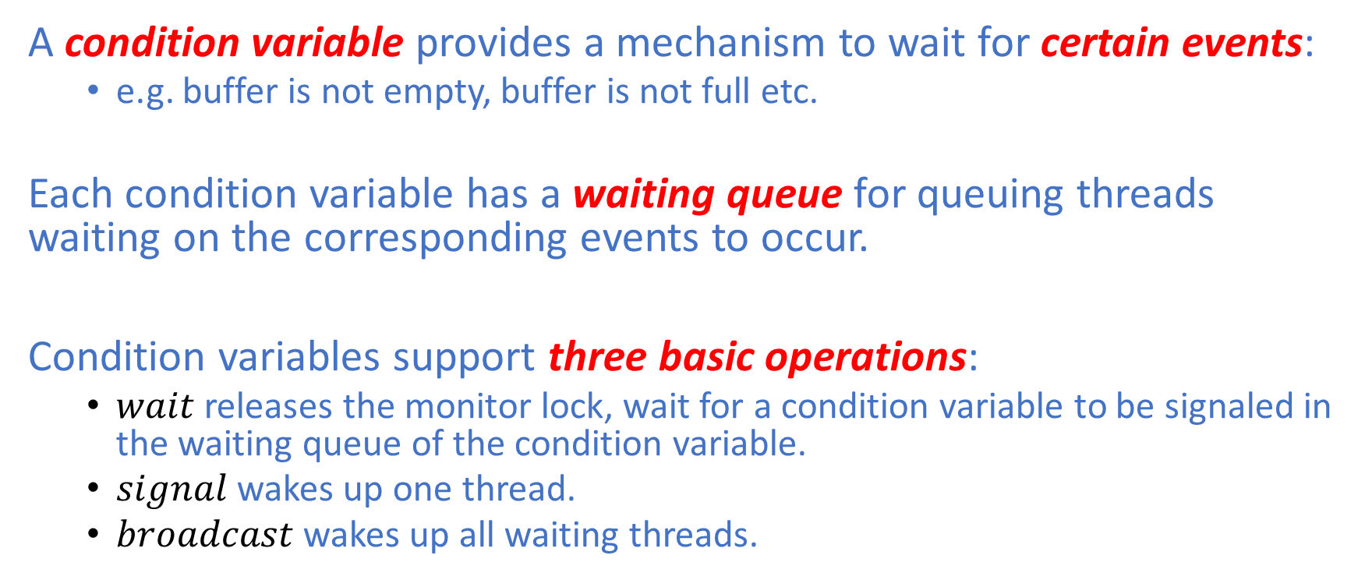
Monitor: Condition Variable
A condition variable provides a mechanism to wait for certain events:
e.g. buffer is not empty, buffer is not full etc.
Each condition variable has a waiting queue for queuing threads waiting on the corresponding events to occur.
Condition variables support three basic operations:
$wait$ releases the monitor lock, wait for a condition variable to be signaled in the waiting queue of the condition variable.
$signal$ wakes up one thread.
$broadcast$ wakes up all waiting threads.

Slide 54
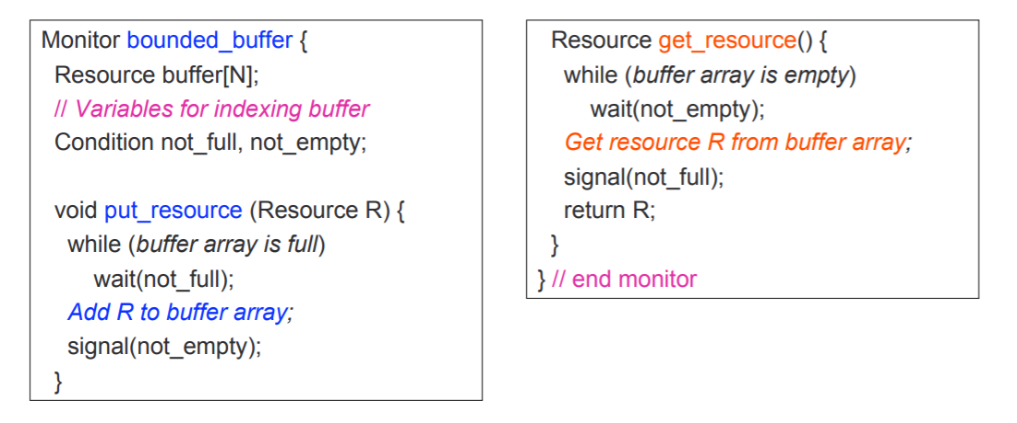
Monitor: Bounded Buffer Problem

Slide 55
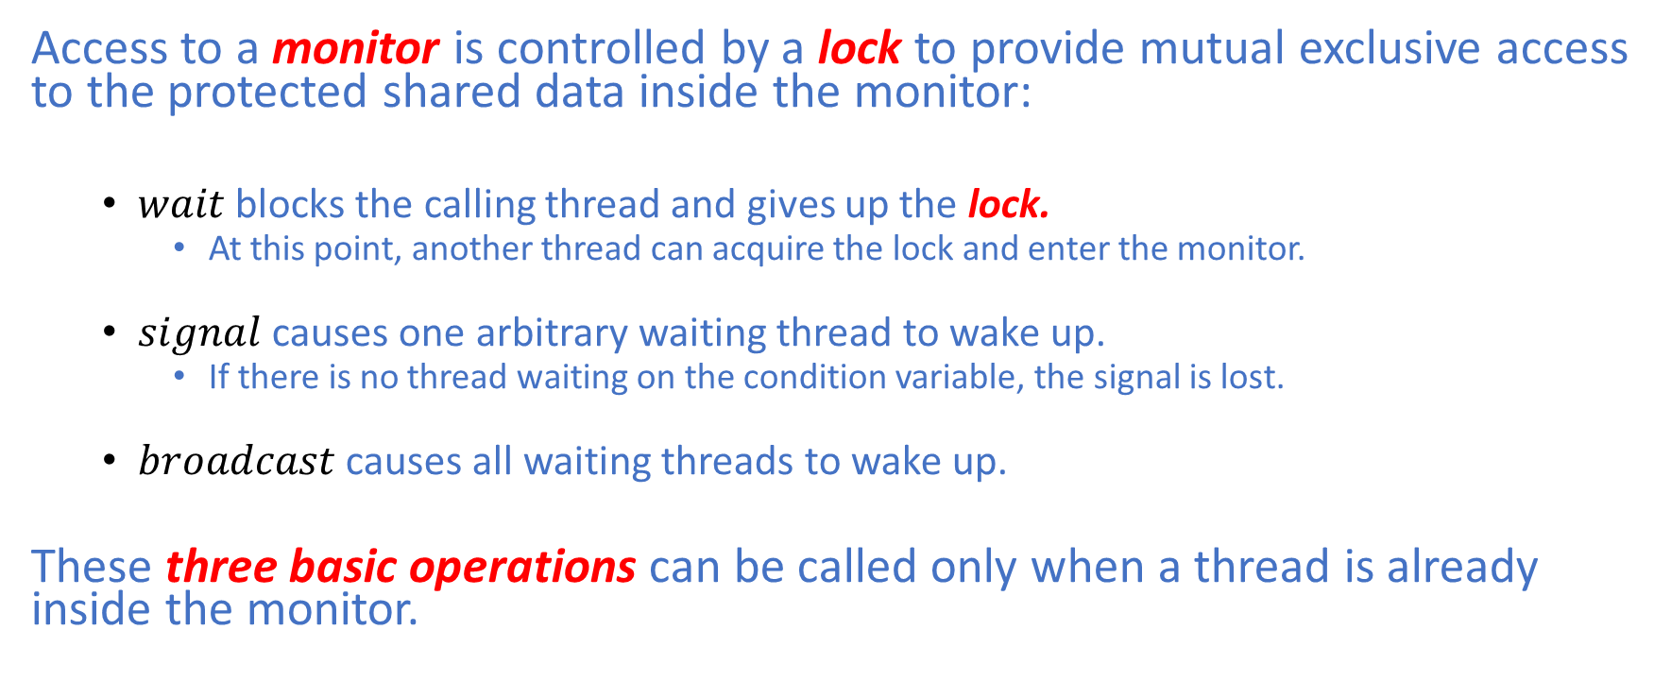
Monitor: Mechanism
Access to a monitor is controlled by a lock to provide mutual exclusive access to the protected shared data inside the monitor:
$wait$ blocks the calling thread and gives up the lock.
At this point, another thread can acquire the lock and enter the monitor.
$signal$ causes one arbitrary waiting thread to wake up.
If there is no thread waiting on the condition variable, the signal is lost.
$broadcast$ causes all waiting threads to wake up.
These three basic operations can be called only when a thread is already inside the monitor.

Slide 56
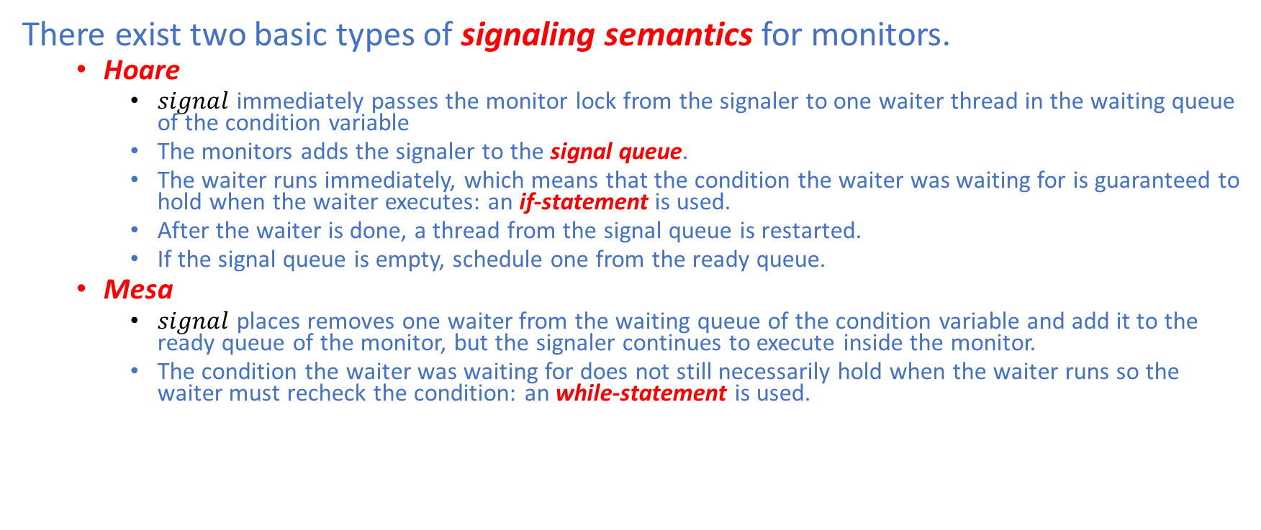
Monitor: Signaling Semantics
There exist two basic types of signaling semantics for monitors.
Hoare
$signal$ immediately passes the monitor lock from the signaler to one waiter thread in the waiting queue of the condition variable
The monitors adds the signaler to the signal queue.
The waiter runs immediately, which means that the condition the waiter was waiting for is guaranteed to hold when the waiter executes: an if-statement is used.
After the waiter is done, a thread from the signal queue is restarted.
If the signal queue is empty, schedule one from the ready queue.
Mesa
$signal$ places removes one waiter from the waiting queue of the condition variable and add it to the ready queue of the monitor, but the signaler continues to execute inside the monitor.
The condition the waiter was waiting for does not still necessarily hold when the waiter runs so the waiter must recheck the condition: an while-statement is used.

Slide 57
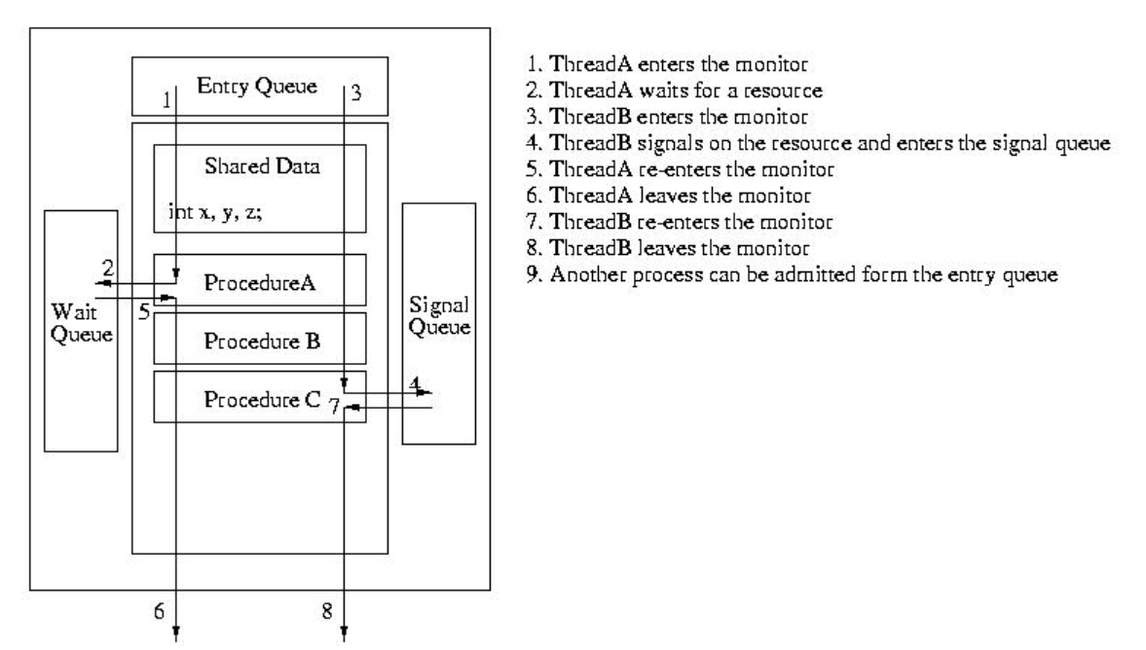
Monitor: Hoare

Slide 58
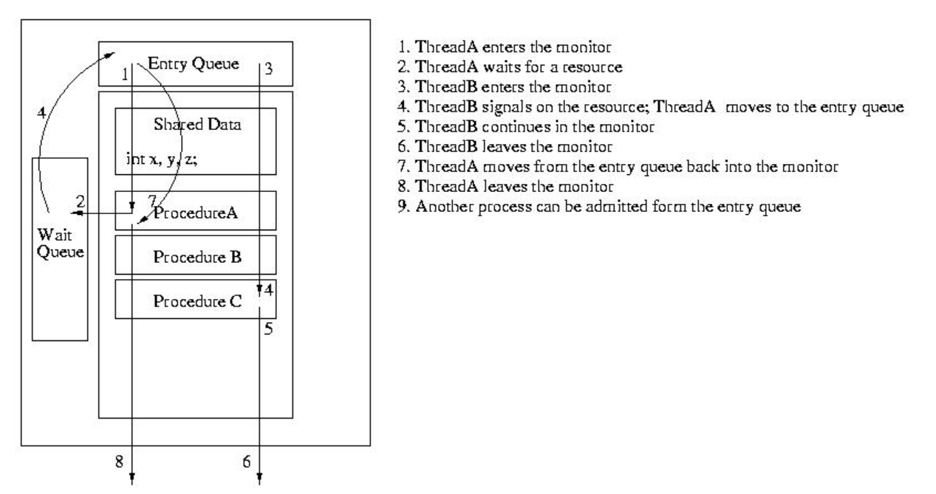
Monitor: Mesa

Slide 59
Monitor: Signaling Semantics
Trade-offs:
Hoare Semantics:
+ More deterministic, hence easier to reason about
Less efficient due to more context switches
Broadcast is hard
Mesa Semantics:
+ less deterministic
+ Broadcast is easy
- More efficient due to fewer context switches

